Slide 1

Sponsored by:
The World Data Science Institute is the premier place to get Financial Data Science Education.

Slide 2
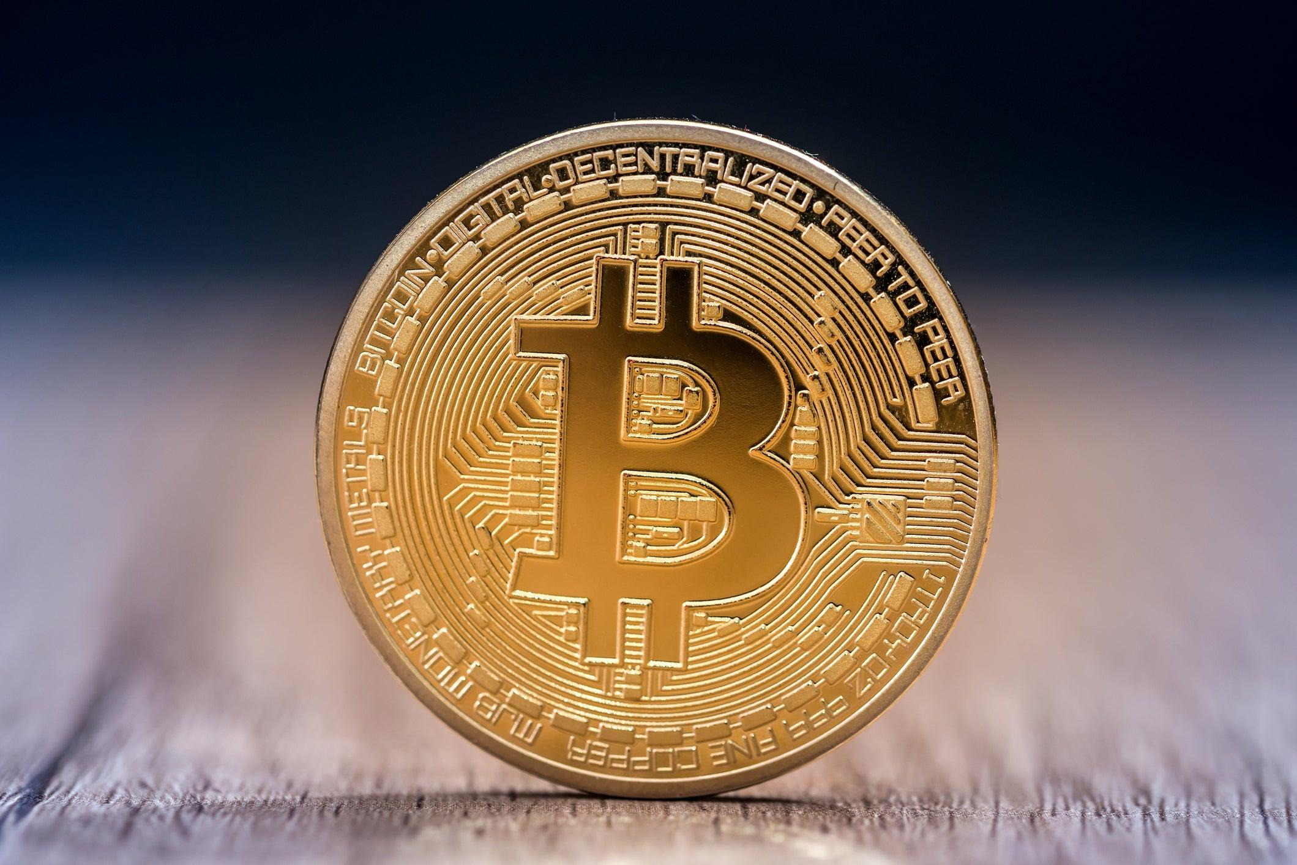
Varieties of Cryptocurrency
Created by Matthew Wilps
https://www.linkedin.com/in/mattwilps/

Slide 3
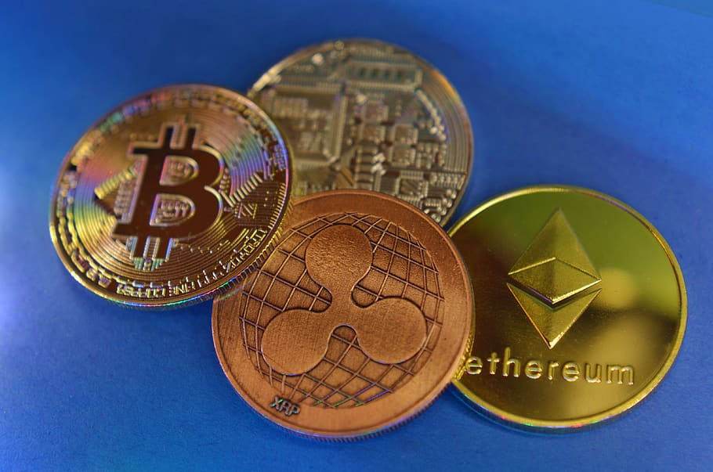
Popular Cryptocurrencies
Bitcoin
Ethereum
Polkadot
Tether
Litecoin
CHainlink
Cardano
USDC
Stellar
Augur

Slide 4
Buzz words
Cryptocurrency- a digital currency in which transactions are verified and records maintained by a decentralized system using cryptography, rather than by a centralized authority
Mining- the process of creating crypto currency
Nodes- a computer that connects to the cryptocurrency network
Pow- proof of work
Decentralized- information is stored and governed by many nodes instead of a single (central) node
Open sourced- collaboratively produced and publicly available source code.
Blockchain- is a type of spreadsheet containing information about transactions. Each transaction generates a hash. ... Each block refers to the previous block and together make the Blockchain. A Blockchain is effective as it is spread over many computers, each of which have a copy of the Blockchain..
dApps- decentralized application
References are at the end of this presentation

Slide 5
Bitcoin
Bitcoin is a cryptocurrency released in 2009 by an individual or group of people using the name Satoshi Nakamoto.
It is the most popular and considered the first successful cryptocurrency
It is a decentralized open- sourced blockchain cryptocurrency that uses Nodes to verify each transaction
Has a finite supply

Slide 6
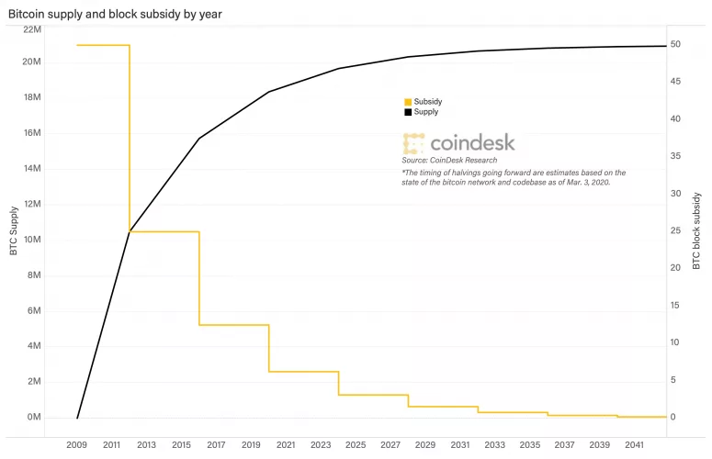
How is Bitcoin made?
Computers race to solve algorithms in order to earn bitcoin using cryptography (Mining) Each block is added to the chain.
Each Node has to show PoW (Proof-of-Work) in order to receive payment
Bitcoin is designed to have a finite supply (just like the amount of Gold on earth)
As the supply of Bitcoin shrinks each block becomes progressively more difficult to mine (just like gold).
More specifically every 4 years the amount of bitcoin earned per block is halved as it was designed to do.
The supply of bitcoin is predicted to be exhausted in 2041.
Miners will still be able to earn bitcoin by verifying transfers of Bitcoin

Slide 7
Bitcoin use cases
Bitcoin can be used as an investment to protect from hyperinflation
As an untraceable currency it has enormous value on the dark web
Since no physical transaction takes place it can be transferred in high quantities at a relatively low cost
Difficult to hack because each node stores and approves each transaction

Slide 8
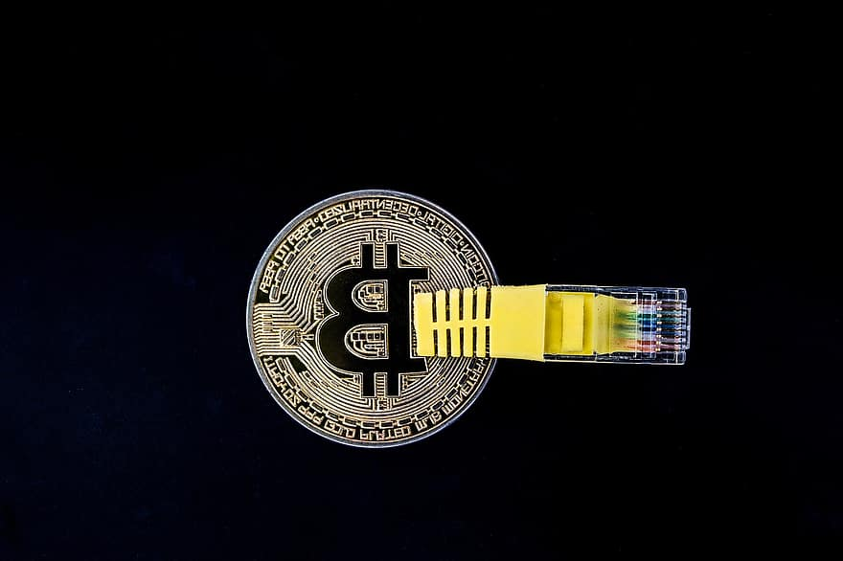
What problem does Bitcoin solve?
Double spending- digital assets used to be managed by large organizations because they were so easy to copy.
Bitcoin is decentralized and all of the Nodes need to agree to any changes to the blockchain, compared to the US Dollar which is controlled by One entity.
Bitcoin can be used anonymously. Protecting exchanges from government scrutiny

Slide 9
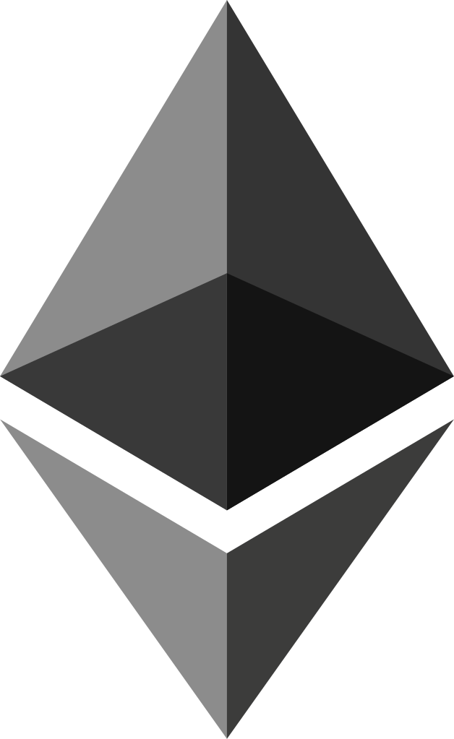
Ethereum
Decentralized open- source blockchain that uses smart contract capabilities
Uses Ether as a currency for automated smart contracts on the Ethereum network
Nodes can store currency as well as smart contracts and dApps in a decentralized database

Slide 10
Ethereum Mining
Very similar to Bitcoin mining in that it uses a Pow (Proof-of-Work) concept to mine bitcoin blocks in an computationally intensive action.
Soon, Ethereum developers hope to start using a different method, called PoS (Proof-of-Stake). This method uses much less electricity, so it’s a lot better for energy costs and the planet!
There is no cap to the amount of ether that can be mined. However the quantities are unlikely to raise too high.

Slide 11
Ethereum use cases
Matthew writes tutorials using Google Docs. He can edit his work and share it with whoever he wants. One day Google Docs is hacked, or the government bans it, so Matthew loses all his work.
Now Matthew decides that he will only use the word processor on his computer, so his work will be safe. But it isn’t safe, is it? Matthew’s computer can be lost, broken, or hacked into.
Matthew is desperate now, so he decides to sell his laptop and buy a pencil, a notepad, and some stamps instead. Job done!
Matthew’s problem here is that he wants the convenience and speed of the internet, but with the control and safety of his pencil and paper. But what is Ethereum going to do about it?
Ethereum offers a way to use the power of the internet without trusting apps like Facebook, Google, or your online bank with your personal information.
https://www.bitdegree.org/crypto/what-is-ethereum#:~:text=In%20both%20Bitcoin%20and%20Ethereum,rewarded%20with%20a%20new%20Ether.
Uses Ether as a currency
Smart contracts
dApps- Decentralized apps

Slide 12
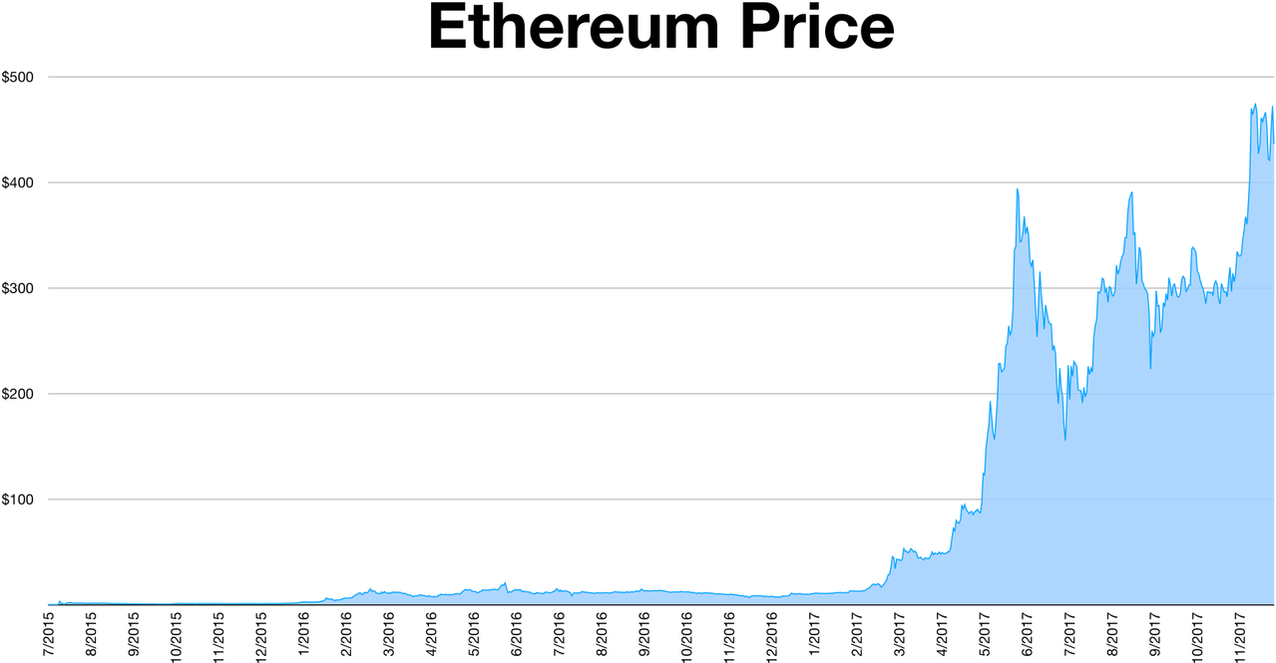
What problems does Ethereum solve?
Expands on the decentralizing goal of bitcoin, instead of only offering currency it aims to decentralized the entire internet through the use of smart contracts and dApps
Very secure
Much more scalable than Bitcoin
Transactions are much quicker than Bitcoin

Slide 13

Polkadot
Allows cross-blockchain asset transfers
Bitcoin created cryptocurrency, ethereum added the functionality of linking cryptocurrency to smart contracts and dApps, Polkadot adds the functionality to trade currency across different dApps more efficiently
Provides a more complete solution to a decentralized internet

Slide 14
Polkadot mining
The Polkadot network allows for the creation of three types of blockchains.
The Relay Chain – The main Polkadot blockchain, this network is where transactions are finalized. To achieve a greater speed, the relay chain separates the addition of new transactions from the act of validating those transactions. This model allows Polkadot to process over 1,000 transactions per second, according to 2020 testing.
Parachains – Parachains are custom blockchains that use the relay chain’s computing resources to confirm that transactions are accurate.
Bridges – Bridges allow the Polkadot network to interact with other blockchains. Work is underway to build bridges with blockchains like EOS, Cosmos, Ethereum and Bitcoin, which would allow tokens to be swapped without a central exchange.
https://www.kraken.com/en-us/learn/what-is-polkadot-dot

Slide 15

Polkadot use cases
Polkadot presents a solution to scalability and customization of decentralized application
To begin, Polkadot is designed to operate with two types of blockchains. A main network, called a relay chain, where transactions are permanent, and user-created networks, called parachains. Parachains can be customized for any number of uses and eventually feed into the main blockchain, so parachain transactions benefit from the same security of the main chain

Slide 16
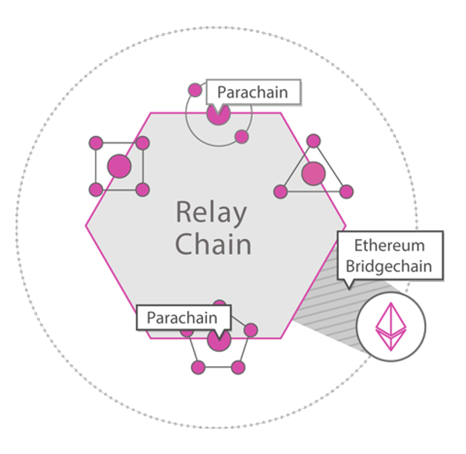
What problems does Polkadot solve
Uses a 2 stage blockchain system in which users can create unique blockchains to serve their specific use and then have that data uploaded onto shared nodes to increase efficiency.
It also aims to create a way for different blockchain currencies to trade in an efficient manner

Slide 17
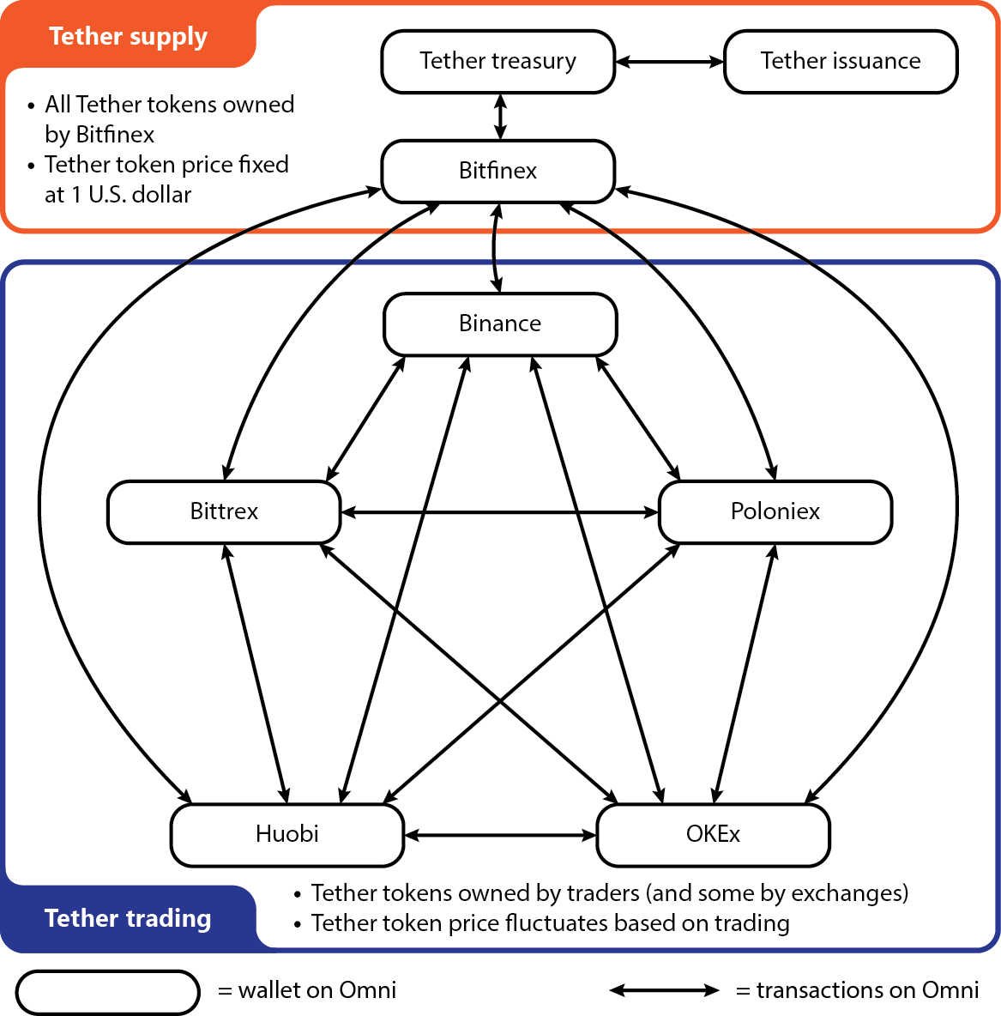
Tether
A fiat collateralized stablecoin -a fiat currency like the US dollar, the euro, or the yen, backs each cryptocoin in circulation
Every Tether+ token is backed 100% by its original currency, and can be redeemed at any time with no exposure to exchange risk.

Slide 18
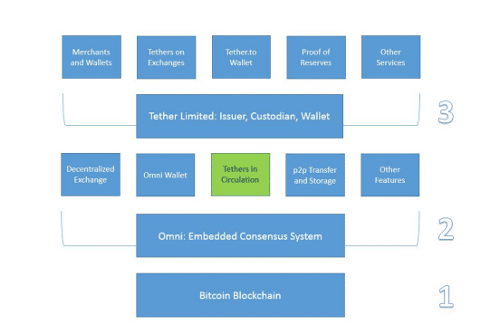
Tether Production
Tether is not mined because it is linked to the actual amount of currency in reserves
However it does use a POS and POR (Proof of Research) to validate transactions

Slide 19
Tether use cases
Meant to be a more secure asset because it is tied to traditional currencies.
Tether was specifically designed to build the necessary bridge between fiat currencies and cryptocurrencies and offer stability, transparency and minimal transaction charges to users. It is pegged against the U.S. dollar and maintains a 1-to-1 ratio with the U.S. dollar in terms of value. However, there is no guarantee provided by Tether Ltd. for any right of redemption or exchange of Tethers for real money – that is, Tethers cannot be exchanged for U.S. dollars.

Slide 20
What problems does Tether solve
Since tether is supposed to be backed by traditional currency it should avoid the wild fluctuations of other bitcoins
Tether is currently under scrutiny for avoiding an audit on how much reserves they actually hold

Slide 21
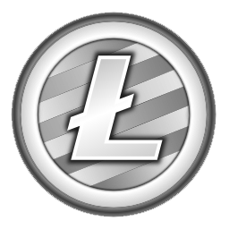
Lite Coin
LTC currently trails behind Bitcoin as the 5th-largest digital currency by market cap, as of January 2021
A Bitcoin spinoff created in 2011 by founder Charlie Lee as a “Lite version of bitcoin”
Designed to be the silver to Bitcoin’s gold

Slide 22
How is Litecoin Made
Using POW Litecoin is mined the same way as bitcoin
Uses (Scrypt) a different cryptographic algorithm than bitcoin (SHA-256).
Bitcoin miners use specially built hardware to mine these complex algorithms meanwhile
Litecoin’s Scrypt is much less susceptible to these special built machines therefore is more accessible to the masses

Slide 23
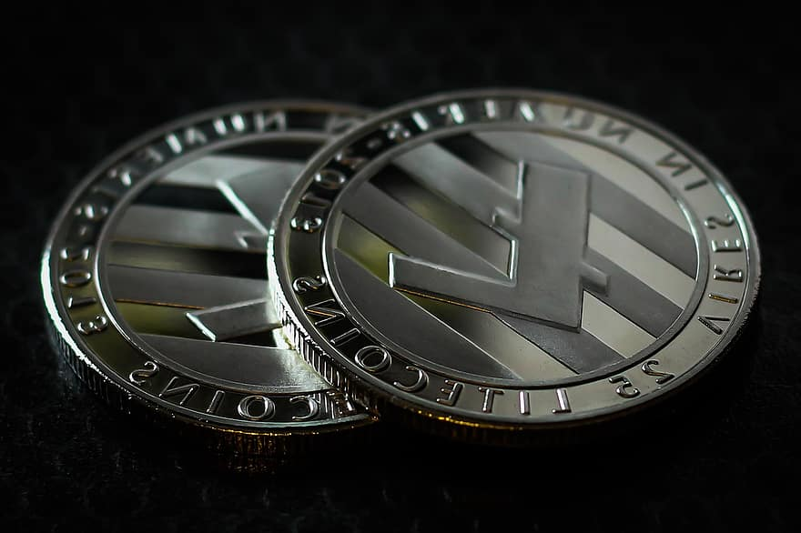
What problems does Litecoin solve
Litecoin supply is capped at 84 million coins. Four times more than Bitcoin.
Slightly faster transaction times than bitcoin
Lower price may facilitate the psychology in trading Litecoin vs Bitcoin

Slide 24
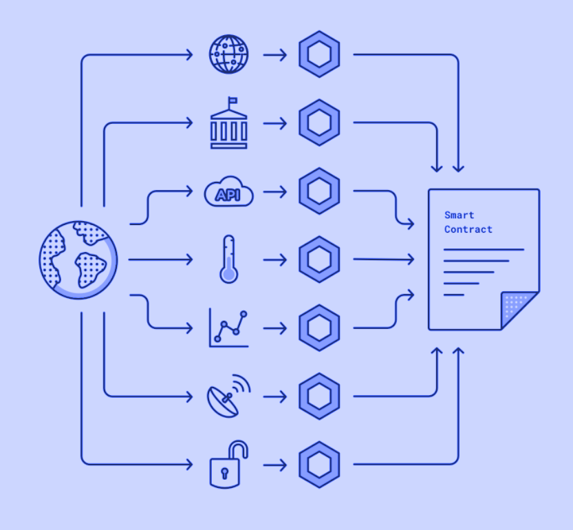
Chainlink
Decentralized oracle network that provides real-world data to smart contracts on the blockchain
Since smart contracts depend on real world data in order to be completed there is pressure in providing a decentralized way of collecting information. Chain Link provides this decentralized data
Link is the digital asset token used to pay for services on the network

Slide 25
How is Chainlink made?
Requesting Contract holders use LINK to pay Chainlink node operators for their work. Prices are set by the Chainlink node operator based on demand for the data they can provide and the current market for that data.
Chainlink node operators also use LINK to stake in the network — node operators must deposit LINK with Chainlink to demonstrate their commitment to the network and incentivize good service.
The Chainlink Reputation Contract considers the size of a node’s stake (among other criteria) when matching nodes with requests for data. Nodes with a greater stake are therefore more likely to be chosen to fulfill requests (and thus earn LINK for their services). The Chainlink network also punishes faulty or dishonest nodes by taxing their stake of LINK for poor service.
LINK is built on Ethereum in accordance with the ERC-20 standard for tokens. It can be bought and sold for fiat currency or other digital currencies.

Slide 26
Chainlink Use cases
Verification for Data used to execute smart contracts.
This data is then linked to a digital asset called Link
Verifies the accuracy of the data by pulling from multiple sources.

Slide 27

What problems does Chainlink solve?
Smart contracts require accurate data and if we were to call data from one centralized source it could be manipulated. Chainlink decentralizes the data
It can also gather data from multiple sources and organize it to be used in a smart contract
Adds a system of checks and balances to smart contracts

Slide 28
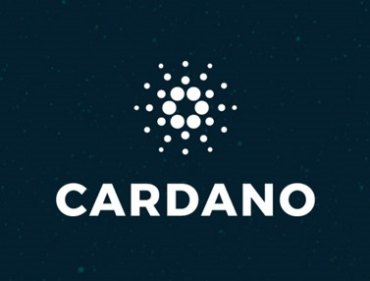
Cardano (ADA)
Proof of stake blockchain platform
Founded on peer reviewed research
Developed through evidence-based methods
Has two layers:
Cardano Settlement Layer- acts as the account layer where transactions are processed with minimal transaction fees
Cardano Computational Layer (CCL)- runs smart contracts, ensures security and compliance, and other more advanced use cases

Slide 29
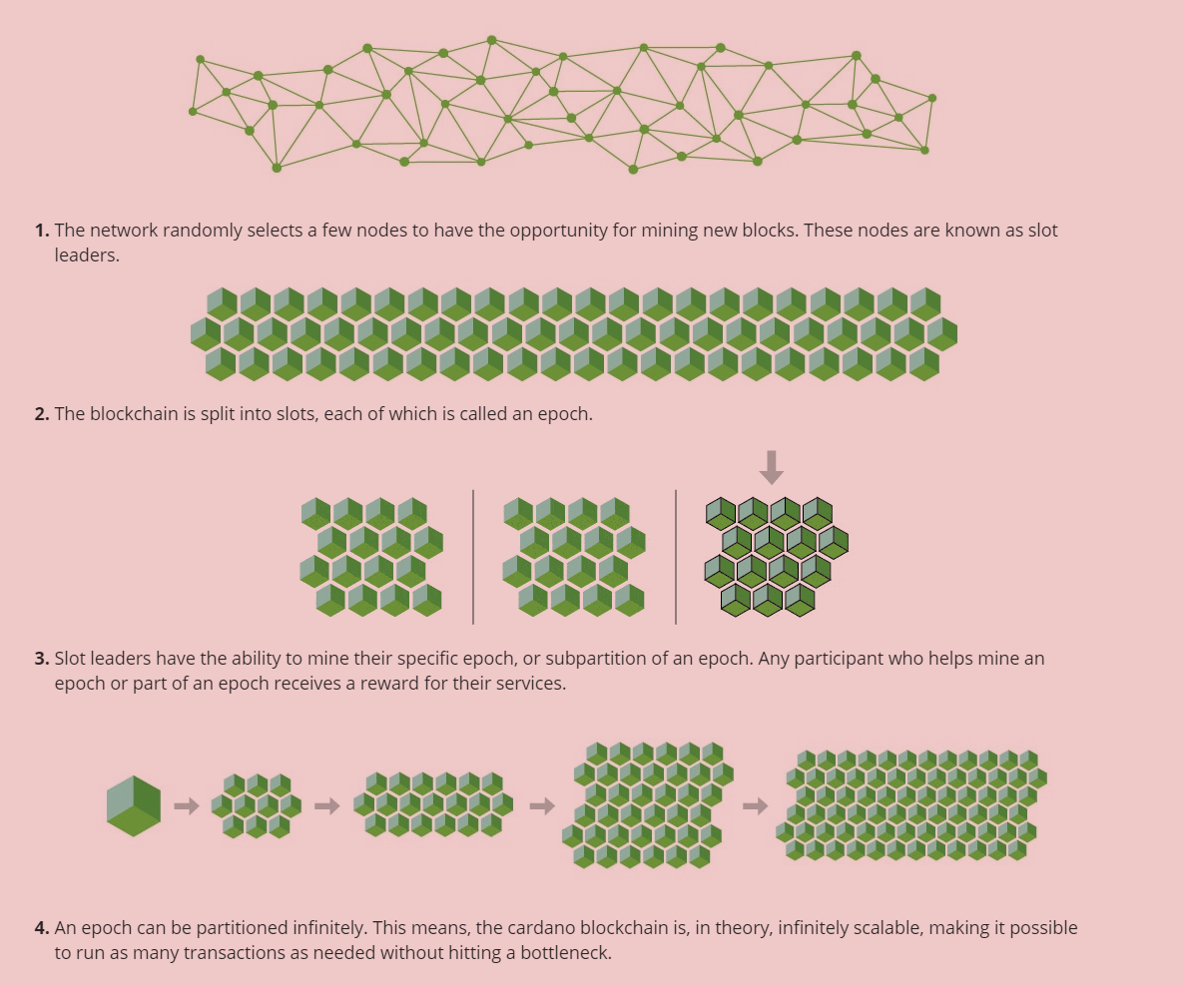
How is Cardano is made
Uses POS (Proof of Stake technology) Cardano calls their POS Ouroboros
Ouroboros uses a mathematically and statistically efficient method to select who is allowed to mine which nodes

Slide 30

Cardano use cases
Decentralized applications on Cardano can be used for the following:
Credential verification (diplomas)
Product counterfeiting (retail, health care)
Supply chain tracking (agriculture)
Digital Identity (ID cards, and identity verification)

Slide 31
What does Cardano solve
Faster and more flexible than Bitcoin
Safer and more scalable than ethereum
3rd generation bitcoin
Designed to be infinitely scalable

Slide 32
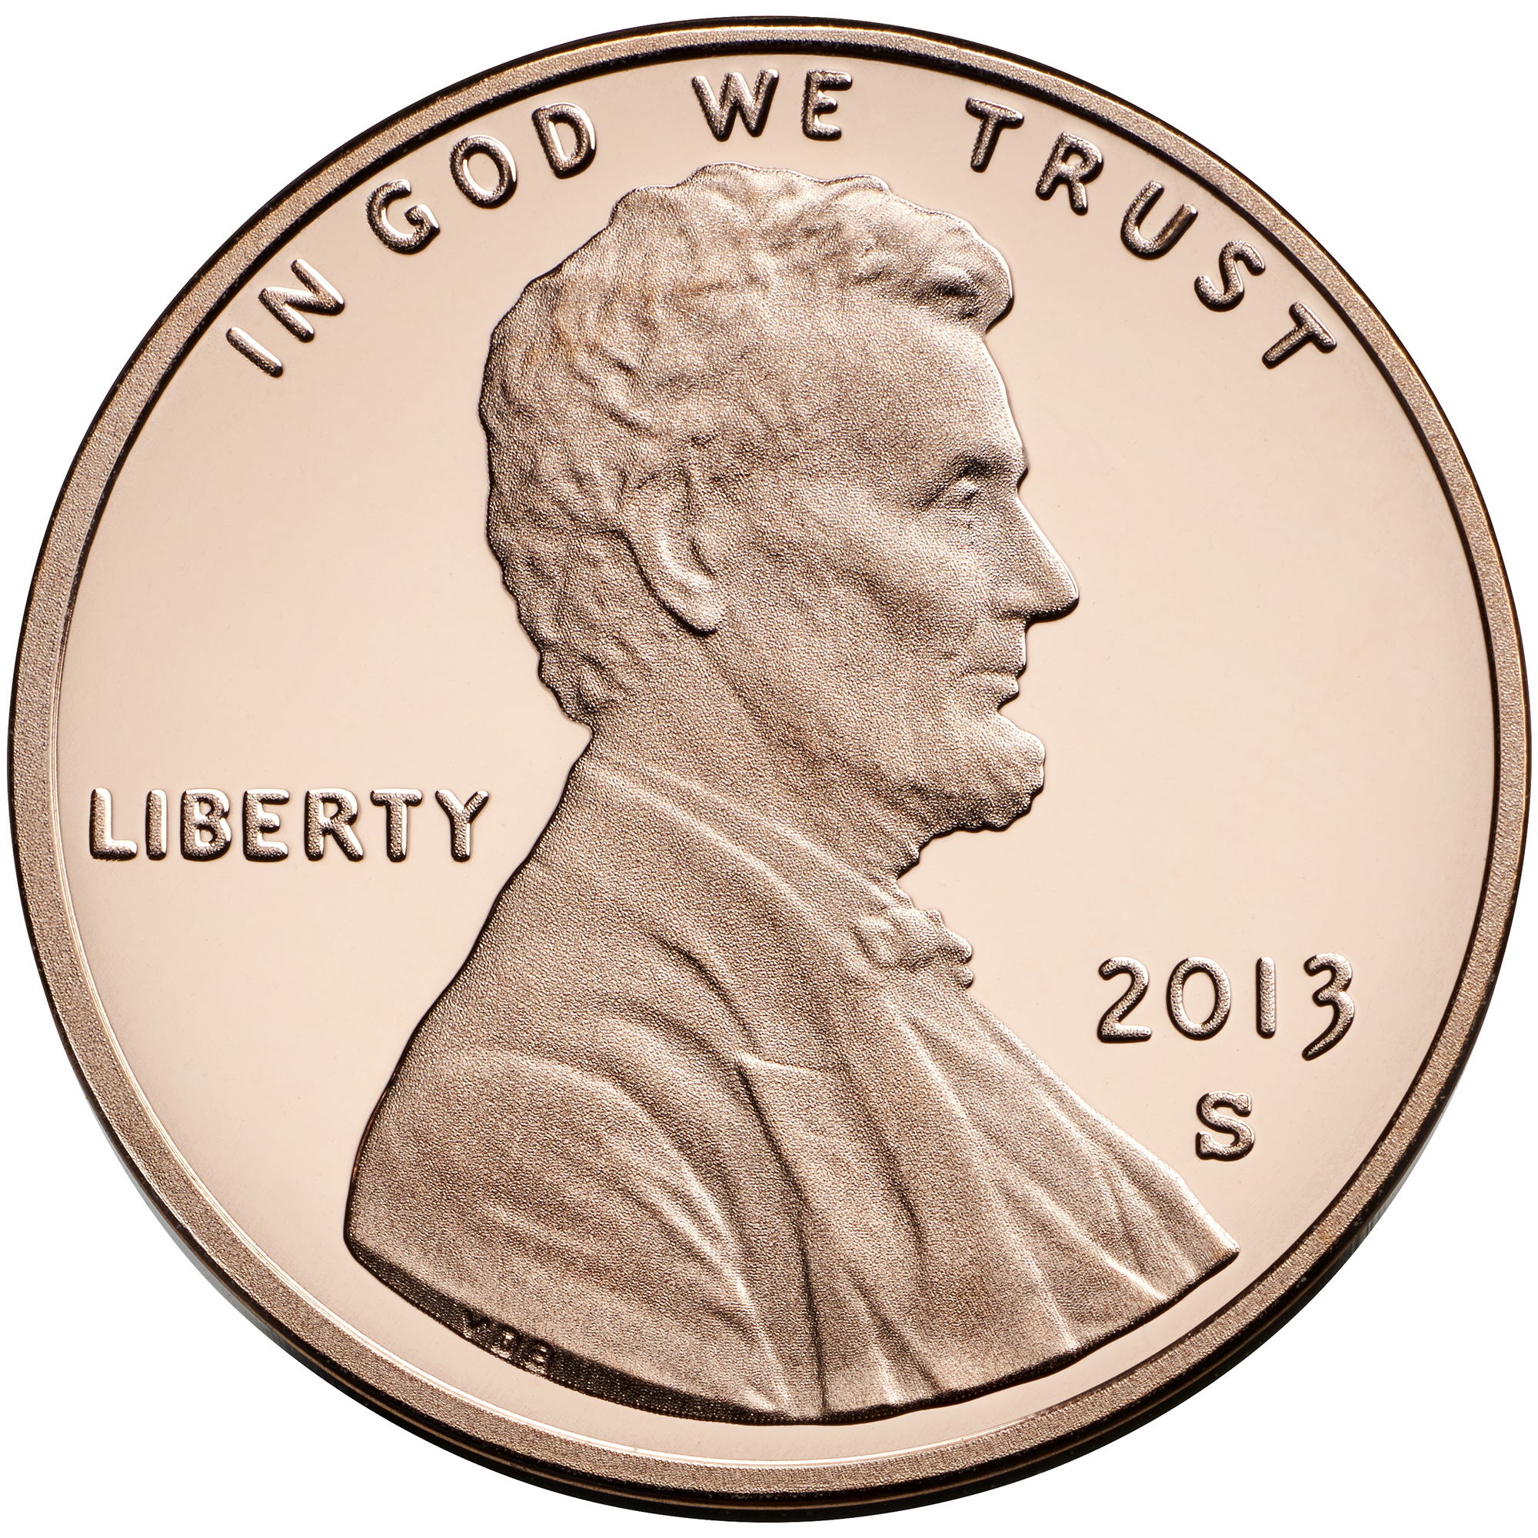
USDC
USD Coin is a stable coin pegged at the US dollar
Reserves are governed by the Centre Consortium, and are attested to by global accounting firm, Grant Thornton LLP.
1 Coin = 1 US dollar

Slide 33
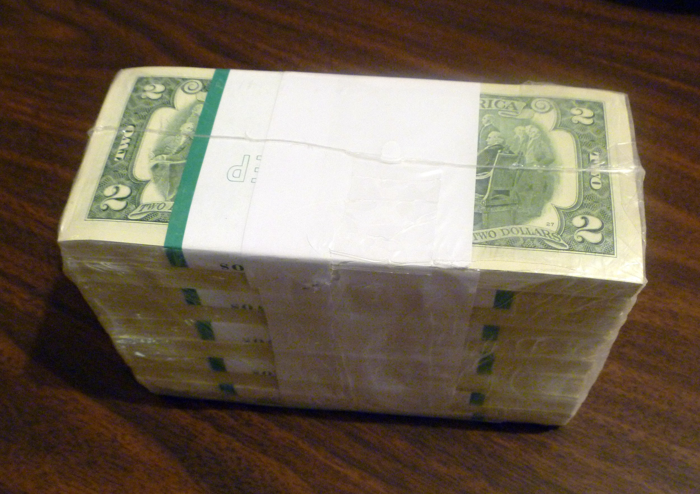
How is USDC created
Since the USDC is linked to the US dollar they are equal to the amount of US dollars supposed to be held in a reserve

Slide 34
USDC use cases
Send and receive digital dollars
Multichain support - Swap across any USDC supported blockchain or currency at no cost
Convert digital dollars from your bank account
Enterprise ready custody and security of digital currency
Similar to mobile payment solutions except for use with crypto

Slide 35
What problems does USDC solve?
Compared to other major stablecoin, Tether (USDT), USDC is much more present on decentralized exchanges and applications, which means it is inherently stickier than Tether, which is used more for centralized exchange arbitrage.
USDC is especially attractive for businesses and financial institutions looking to integrate blockchain technology because Circle provides platform services and APIs that make it easier to integrate.

Slide 36
Stellar
Open source, decentralized protocol for digital currency to fiat money transfers
Lets anyone build low cost financial services
Uses a Digital currency called Lumens
To complete the system, the developers of the network made Lumens into an inflationary currency with a fixed increase rate of 1% per year.

Slide 37
How are Lumens made
It runs a network of decentralized servers with a distributed ledger that is updated every 2 to 5 seconds among all nodes.
Unlike Bitcoin, Stellar uses consensus protocol that does not rely on the entire miner network to approve transactions. Instead, it uses the Federated Byzantine Agreement (FBA) algorithm, which enables faster processing of transactions.
Each node in the Stellar network chooses another set of “trustworthy” nodes. Once a transaction is approved by all nodes within this set, then it is considered approved.

Slide 38

What are Stellars use cases
Cross-border Transfers
Anchors in more currencies.
Mobile and trading clients.
API Mashups.
Merchant plugin.
Microsavings account for school, health, insurance.
Microinsurance.
P2P lending.
Conditional cash transfers.

Slide 39
What problems does Stellar solve
Decentralized control
Low latency
Flexible trust
Asymptotic security
Stellar chain requires all users to hold a minimum of 20 Lumens in every single account to ensure that they are authentic and to maintain a seamless flow of transactions.

Slide 40
Augur
Augur is a decentralized Application that lives on the ethereum network and is a convenient way for people to bet on real world events.
Powered by Ethereum
A decentralized gambling platform- anyone can create a betting market based on real world events
The outcomes of each event is determined by Augur’s oracle, which brings real-world information onto the blockchain.

Slide 41

What is a use case for Augur
Augur is a gambling platform that can be used to place bets on anything happening in the real world. Someone just needs to accept the terms. This can be a powerful force in improving the accuracy of big data worldwide

Slide 42
What problems does Augur solve?
Augur provides a novel solution to bad data. Similar to the way the stock market helps allocate funds and appropriately disperse capital. Augur allows trading of information which in theory should encourage the appropriate allocation of data

Slide 43
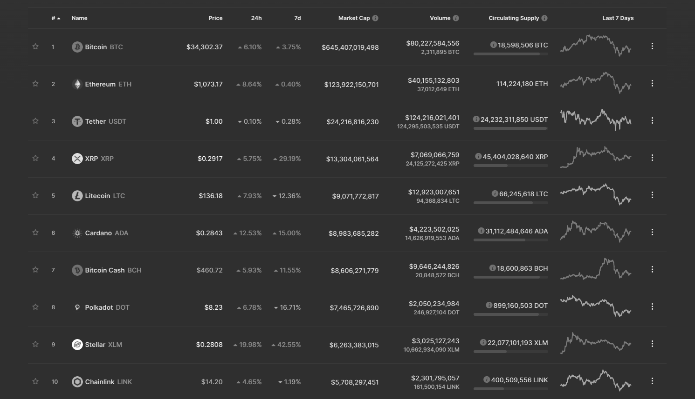
Crypto Market Cap 1/12/2021

Slide 44
Resources
https://www.coindesk.com/bitcoin-halving-explainer
https://www.bitdegree.org/crypto/what-is-ethereum#:~:text=In%20both%20Bitcoin%20and%20Ethereum,rewarded%20with%20a%20new%20Ether.
https://www.researchgate.net/publication/340859731_Decentralized_Cross-Blockchain_Asset_Transfers
https://www.investopedia.com/terms/t/tether-usdt.asp#:~:text=Tether%20is%20a%20blockchain%2Dbased,trade%20under%20the%20USDT%20symbol.
https://www.gemini.com/cryptopedia/what-is-chainlink-and-how-does-it-work
https://www.americascardroom.eu/augur-cryptocurrency/
https://www.investopedia.com/articles/investing/042015/bitcoin-vs-litecoin-whats-difference.asp
https://bitcoinchaser.com/stellar-lumens#:~:text=The%20Stellar%20Lumens%20Consensus%20Protocol,PoS)%20to%20secure%20its%20blockchain.
https://en.wikipedia.org/wiki/Main_Page
https://www.leewayhertz.com/what-is-stellar-blockchain/

